Slide 1
Introduction to Data Mining
Key Performance Indicators in Supply Chain Management
Final Presentation
6/15/2018 - 6/17/2018
Team
Naveen (002836193)
Sai Charan (002835600)
Suhas (002835627)

Slide 2
Agenda - Overall
Introductions
What is Supply Chain Management
Key Performance Indicators in SCM
Current Data Mining approaches in SCM
KPI Implementation based on the Data Mining approaches

Slide 3
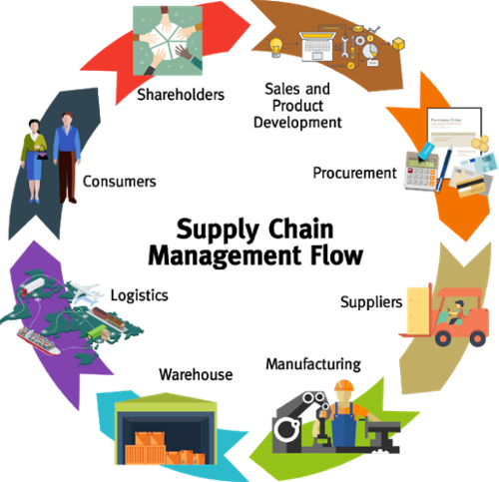
Introduction
Source: https://www.nevprobusinesssolutions.com/supply-chain-management/

Slide 4
Supply Chain Management
SCM is a dynamic administration of Supply chain activities to expand client advantage and accomplish a practical competitive advantage.
It speaks to a best effort put in by the supply chain firms to create and run supply chains in the best and proficient ways that could be available.
SCM covers every single phase like Product Improvement, Marketing, Creation, Logistics and frameworks which are needed in the production.

Slide 5
COMPONENTS OF SUPPLY CHAIN MANAGEMENT
To Convert the raw product into a final product, below are the 5 important components:
Plan
Develop(Source)
Make
Deliver
Return

Slide 6
KEY FEATURES OF SUPPLY CHAIN
The Key features of SCM are as below:
Inventory Management
Order Management
Procurement
Logistics
Return Management

Slide 7
Key Performance Indicators
KPI’s are of 2 types:
Standard KPI
Cross Functional KPI
Below are some factors of Standard KPI
Order Supremacy
Managing the inventory
Costing and supplier management
Producing of the Goods and Manufacturing
Warehousing
Transportation

Slide 8
Key Performance Indicators
Cross Functional KPI’s are likely to provide snapshots of the following end factors:
Perfect order (the degree of accuracy to which customers’ requirements are being met)
Inventory levels
Stock losses and/or damages
Gross profit
Cost of goods sold
Total logistics cost

Slide 9
Current Data Mining approaches in SCM
Market segmentation based on organizational needs of distinct groups.
Market Analysis - retailers can understand the purchasing behavior of the customers.
Target promotion with the use of a computerized approach and an extensive data mining.
Predictions the supply uncertainties at the supplier and item level.
Predictions of process uncertainties can be loss and item damage.

Slide 10
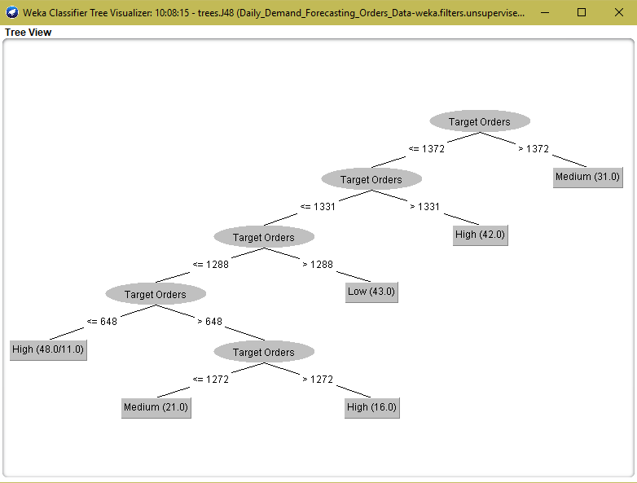
DECISION TREE

Slide 11
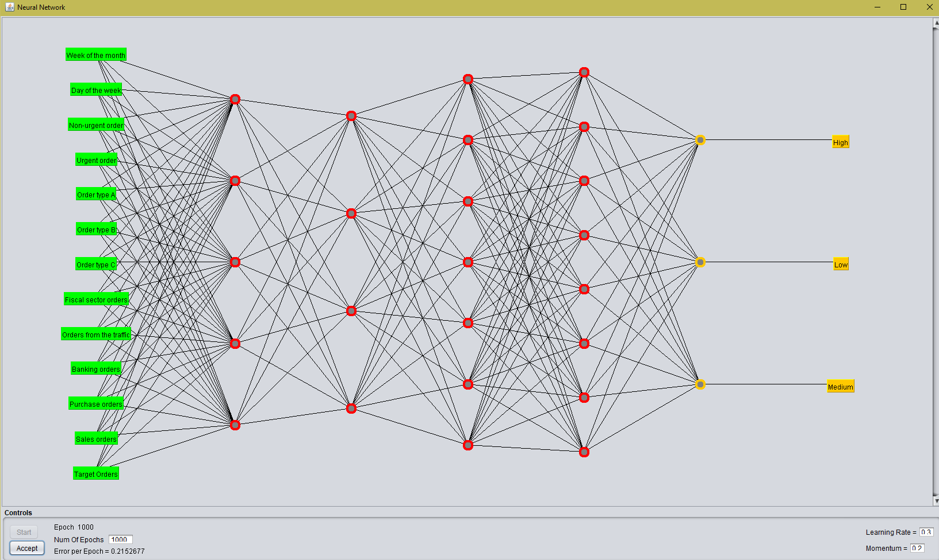
NEURAL NETWORK (MULTI-LAYERED PERCEPTRON)

Slide 14
Conclusion
So, as per the research made the datamining concepts determine the key performance indicators like “Demand Forecasting” in a supply chain management organization. It has been clearly shown that the decision tree algorithm and the neural network created using multi-layered perceptron algorithm will help the users to easily predict and analyze the stock and inventory data of an organization. It also helps to easily understand the flow between the nominal values like order demand and remaining factors like target orders which are numerical values.

Slide 15


“https://github.com/chvmnaveen/DataMining_KPIImplementationinSCM.git”
“datahacksgroup.slack.com”
HAPPY DATA MINING !!

